Slide 1
Stredná odborná škola drevárska a stavebná Krásno nad Kysucou
Odborná angličtina
Mgr. Dagmar Mečárová, Mgr. Eva Sýkorová

Slide 2
Prioritná os: Vzdelávanie
Špecifický cieľ: 1.2.1 Zvýšiť kvalitu odborného vzdelávania a prípravy reflektujúc potreby trhu práce
Prijímateľ: Stredná odborná škola drevárska a stavebná Krásno nad Kysucou
Názov projektu: Zvyšovanie kľúčových kompetencií žiakov v Strednej odbornej škole drevárskej a stavebnej v Krásne nad Kysucou s ohľadom na moderné technológie a potreby trhu práce
Kód projektu ITMS2014+: NFP312010AGX2
Názov pedagogického klubu: Odborná angličtina

Slide 3
Advertising goals To inform
inform the market about new or innovated products or about the possibility of new uses
inform the market of price changes
inform about the creation of new stores
explain how the product works
inform the market about new or innovated products or about the possibility of new uses
inform the market of price changes
inform about the creation of new stores
explain how the product works

Slide 4
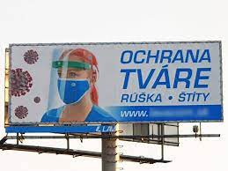
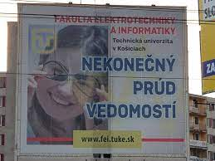
Advertising

Slide 5
Advertising goals To persuade
increase the preferences of the brand
supporting consumer decisions to change brands
change in the perception of certain useful properties of the goods
convince consumers to buy immediately
crisis management through defensive advertising

Slide 6
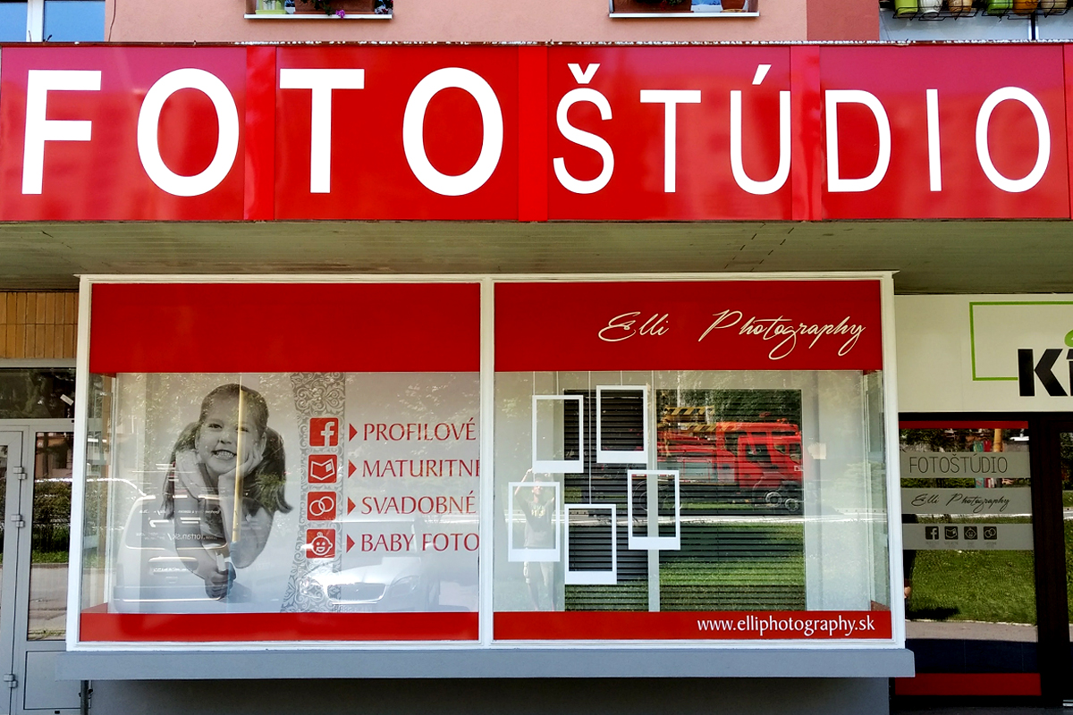
Advertising

Slide 7
Advertising goals To remind
remind consumers that they may need the product in the near future
remind consumers where the goods can be purchased
maintain product awareness even out of season
maintaining consumer loyalty

Slide 8
Advertising goals To compare
point out the advantages of one's own product (services in comparison with a similar competing product or service)

Slide 9
Printed promotional means
- portable: leaflet, brochure, folder, brochure, catalog price list
- stable: poster, interior notice board
- additional: calendar, diary, product label, price tag, sticker, label, postcard, stamps, flags, tickets, vacuum cleaners.

Slide 10
Press promotional means
- periodical press (as an intermediary)
advertising space in a periodical (advertisement, notice, article)
- promotional magazine

Slide 11
Direct promotional means
- letter - invitation - new year card - audio cassette - telephone

Slide 12
Sound promotional means
- radio promotional show - monologue - dialogue - scene - promotional song - sound - broadcasting in department stores - broadcasting in exhibition and trade fair areas - broadcasting in shop windows

Slide 13
Job application form
Personal information
Address
Email address
Education

Slide 14
Useful expressions for job application form
We would appreciate if you would… Ocenili by sme, ak by ste…
I would be grateful if you could… Bol / bola by som Vám vďačný / á, ak by ste mohli…
Could you please send me… Mohli by ste mi prosím poslať…
In addition, I would like to receive… Okrem toho, rád by som ešte dostal…

Slide 15
Job application form

Slide 16
Job application form

Slide 17
Useful expressions for job application form
It would be helpful if you could send us… Veľmi by nám pomohlo, keby ste nám mohli poslať …
I would appreciate your immediate attention to this matter. Ocenili by sme Vašu okamžitú pozornosť tejto veci.
Please let me know what action you propose to take. Prosím, dajte nám vedieť, aký krok navrhujete.

Slide 18
Useful expressions for complaint letter
I am writing you to express my dissatisfaction with… Píšem Vám, aby som vyjadrila svoju nespokojnosť ohľadom…
I am writing you to complain about… Týmto sa chcem sťažovať ohľadom…
Please note that the goods we ordered on (date) have not yet arrived Prosím zoberte na vedomie, že tovar, ktorý sme si objednali ešte neprišiel.
We regret to inform you that our order is now considerably overdue. Musíme Vám žiaľ oznámiť, že naše objednávka je značne oneskorená.

Slide 19
Complaint letter

